Slide 1
CS246: Vectors and Matrices
Junghoo “John” Cho
UCLA

Slide 2
“Understanding” Numbers
We “know” numbers. We feel comfortable with dealing with them. We know their relationship
  Q: What is 2? What is ½? What is their relationship?
When we deal with data on a computer, we deal with a whole bunch of numbers
  Images, sounds, videos, text
  At the end of the day there are nothing but numbers in computers!
Q: Do you feel comfortable “a sequence of” numbers? Do you “understand” them like you understand a single number?
  Q: [0.032, 0.184, 0.163, 0.132]. What does it mean?
  Q: What does “multiplying two list of numbers” mean?

Slide 3
Linear Algebra
Theory of vectors and their linear transformation
As it turns out, linear algebra helps us build insights on a whole bunch of numbers and their relationship
  Incidentally, almost all algorithms consist of a sequence of basic linear algebraic operations; matrix addition, multiplication, exponentiation
Let us start with reviewing the notion of “vector”

Slide 4
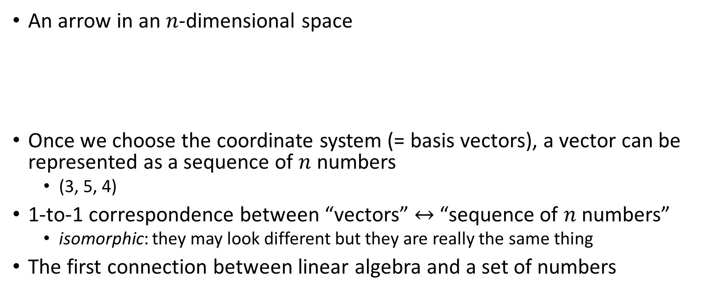
What is a vector?
4
An arrow in an $n$-dimensional space
Once we choose the coordinate system (= basis vectors), a vector can be represented as a sequence of $n$ numbers
  (3, 5, 4)
1-to-1 correspondence between “vectors” $↔$ “sequence of $n$ numbers”
  isomorphic: they may look different but they are really the same thing
The first connection between linear algebra and a set of numbers
5
3

Slide 5



Vector Addition
$\vec{a}+\vec{b}$
Vector addition in number representation:
  $\vec{a}=\left(1, 2, 0\right), \vec{b}=\left(2, 1, 1\right)$
  $\vec{a}+\vec{b}=\left(1+2, 2+1, 0+1\right)=(3, 3, 1)$
  Component-wise addition
$$\vec{a}$$
$$\vec{b}$$

Slide 6






Vector Multiplication
Scalar multiplication: $c\vec{v}$?
Stretch the vector
  $\left|3\vec{v}\right|=3\left|\vec{v}\right|$
Scalar multiplication in number representation
  $\vec{v}=\left(1, 2, 1\right)$
  $3\vec{v}=3\left(1, 2, 1\right)=\left(3∙1, 3∙2, 3∙1\right)=(3, 6, 3)$
  Multiply the number to every component
Dot product: $\vec{a}∙\vec{b}$
$\vec{a}∙\vec{b}=\left|\vec{a}\right|\left|\vec{b}\right|\cos{θ }$
Dot product in number representation
  $\vec{a}=\left(1, 2, 0\right), \vec{b}=\left(2, 1, 1\right)$
  $\vec{a}∙\vec{b}=1∙2+2∙1+0∙1=4$
  Component-wise multiplication
$$\vec{v}$$
3$\vec{v}$
$$\vec{a}$$
$$θ$$
$$\vec{b}$$

Slide 7
Trick Question
Q: (1, 0) vs (0, 1). Are they the same vectors?
A: It depends on the choice of coordinate systems (=basis vectors)
  Choice of basis vectors determines “vector interpretation” of a sequence of numbers

Slide 8
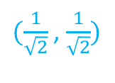
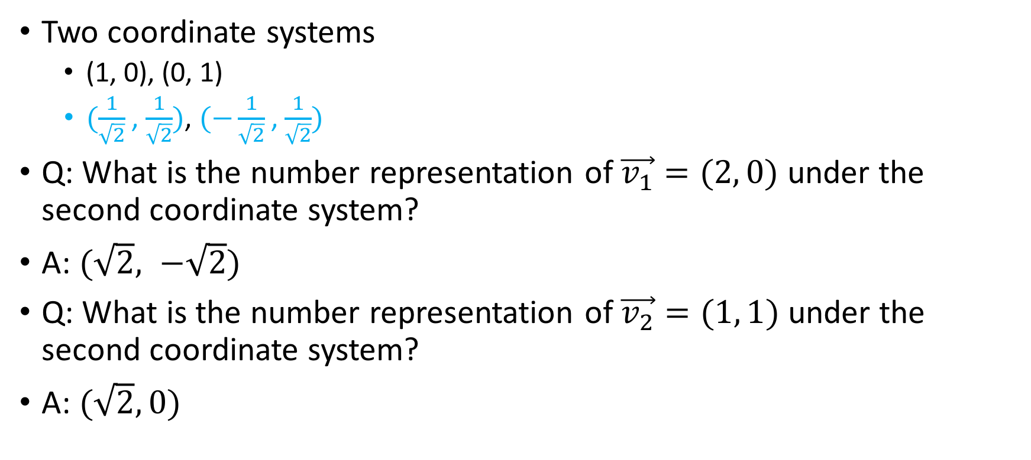


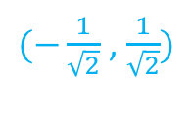
Change of Coordinates (1)
(0, 1)
$$\vec{v_{2}}$$
$(−\frac{1}{\sqrt{2}}$ , $\frac{1}{\sqrt{2}})$
$(\frac{1}{\sqrt{2}}$ , $\frac{1}{\sqrt{2}})$
Two coordinate systems
  (1, 0), (0, 1)
  $(\frac{1}{\sqrt{2}}$ , $\frac{1}{\sqrt{2}})$, $(−\frac{1}{\sqrt{2}}$ , $\frac{1}{\sqrt{2}})$
Q: What is the number representation of $\vec{v_{1}}=(2, 0)$ under the second coordinate system?
A: $(\sqrt{2}, −\sqrt{2})$
Q: What is the number representation of $\vec{v_{2}}=(1, 1)$ under the second coordinate system?
A: $(\sqrt{2}, 0)$
(1, 0)
$$\vec{v_{1}}$$

Slide 9
Change of Coordinates (2)
Q: In general, how can we compute new coordinates of a vector under different basis vectors?
To discuss it, we first take a detour on a matrix and its operations

Slide 10

What is a Matrix?
Two-dimensional array of numbers
  $\left(\begin{matrix}3 & 1 & 8 \\ 5 & 1 & 2 \\ 4 & 6 & 7\end{matrix}\right)$
  Another example of a “whole bunch of numbers”
Matrix as a list of “vectors”
  List of row vectors
    $\left(3, 1, 8\right), \left(5, 1, 2\right), \left(4, 6, 7\right)$
  List of column vectors
    $\left(\begin{matrix}3 \\ 5 \\ 4\end{matrix}\right), \left(\begin{matrix}1 \\ 1 \\ 6\end{matrix}\right)$, $\left(\begin{matrix}8 \\ 2 \\ 7\end{matrix}\right)$
$$\left(\begin{matrix}− & \vec{r_{1}} & − \\ − & \vec{r_{2}} & − \\ − & \vec{r_{3}} & −\end{matrix}\right)$$
$$\left(\begin{matrix}| & | & | \\ \vec{c_{1}} & \vec{c_{2}} & \vec{c_{3}} \\ | & | & |\end{matrix}\right)$$

Slide 11
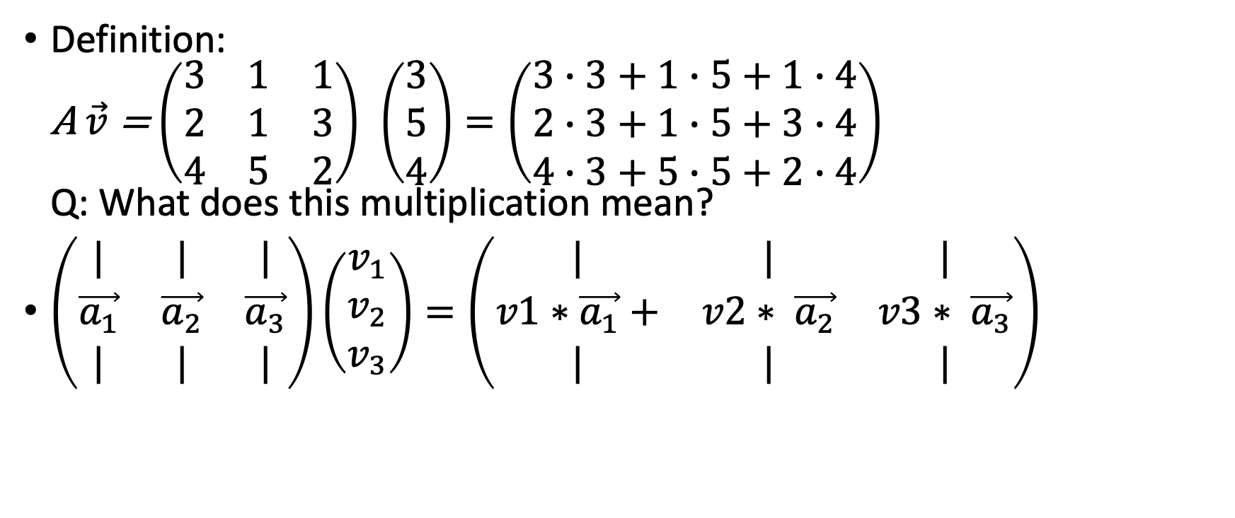

Matrix-Vector Multiplication: $A\vec{v}$
Definition:
A $\vec{v}$ = $\left(\begin{matrix}3 & 1 & 1 \\ 2 & 1 & 3 \\ 4 & 5 & 2\end{matrix}\right)$ $\left(\begin{matrix}3 \\ 5 \\ 4\end{matrix}\right)=\left(\begin{matrix}3∙3+1∙5+1∙4 \\ 2∙3+1∙5+3∙4 \\ 4∙3+5∙5+2∙4\end{matrix}\right)$
Q: What does this multiplication mean?
$\left(\begin{matrix}| & | & | \\ \vec{a_{1}} & \vec{a_{2}} & \vec{a_{3}} \\ | & | & |\end{matrix}\right)\left(\begin{matrix}v_{1} \\ v_{2} \\ v_{3}\end{matrix}\right)=\left(\begin{matrix}| & | & | \\ v1∗\vec{a_{1}}+ & v2∗ \vec{a_{2}} & v3∗ \vec{a_{3}} \\ | & | & |\end{matrix}\right)$

Slide 12
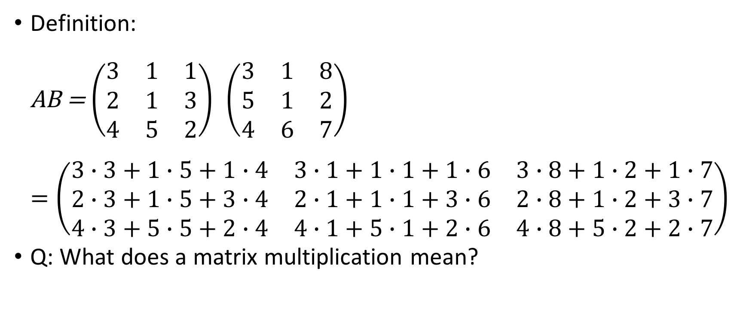

Matrix Multiplication: $AB$
Definition:
AB = $\left(\begin{matrix}3 & 1 & 1 \\ 2 & 1 & 3 \\ 4 & 5 & 2\end{matrix}\right)$ $\left(\begin{matrix}3 & 1 & 8 \\ 5 & 1 & 2 \\ 4 & 6 & 7\end{matrix}\right)$
$=\left(\begin{matrix}3∙3+1∙5+1∙4 & 3∙1+1∙1+1∙6 & 3∙8+1∙2+1∙7 \\ 2∙3+1∙5+3∙4 & 2∙1+1∙1+3∙6 & 2∙8+1∙2+3∙7 \\ 4∙3+5∙5+2∙4 & 4∙1+5∙1+2∙6 & 4∙8+5∙2+2∙7\end{matrix}\right)$
Q: What does a matrix multiplication mean?

Slide 13


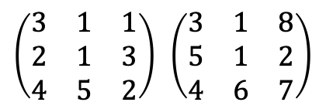

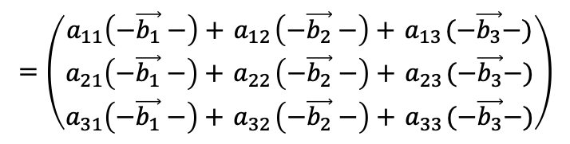
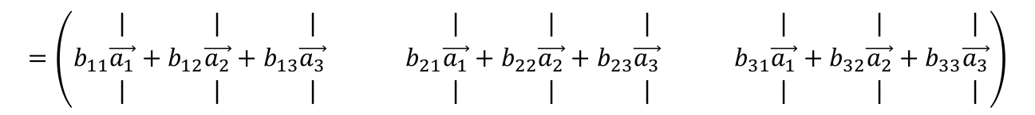
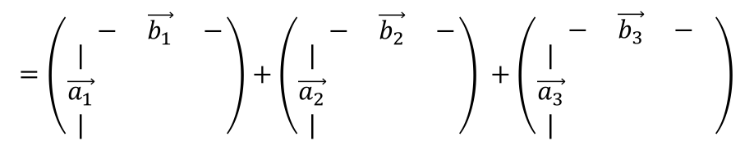
Matrix Multiplication: “Vector Array” View
$$=\left(\begin{matrix}a_{11}\left(−\vec{b_{1}}−\right)+{ a}_{12}\left(−\vec{b_{2}}−\right)+{ a}_{13}(−\vec{b_{3}}−) \\ a_{21}\left(−\vec{b_{1}}−\right)+{ a}_{22}\left(−\vec{b_{2}}−\right)+{ a}_{23}(−\vec{b_{3}}−) \\ a_{31}\left(−\vec{b_{1}}−\right)+{ a}_{32}\left(−\vec{b_{2}}−\right)+{ a}_{33}(−\vec{b_{3}}−)\end{matrix}\right)$$
$\left(\begin{matrix}− & \vec{a_{1}} & − \\ − & \vec{a_{2}} & − \\ − & \vec{a_{3}} & −\end{matrix}\right)$ $\left(\begin{matrix}− & \vec{b_{1}} & − \\ − & \vec{b_{2}} & − \\ − & \vec{b_{3}} & −\end{matrix}\right)$
$\left(\begin{matrix}− & \vec{a_{1}} & − \\ − & \vec{a_{2}} & − \\ − & \vec{a_{3}} & −\end{matrix}\right)$ $\left(\begin{matrix}| & | & | \\ \vec{b_{1}} & \vec{b_{2}} & \vec{b_{3}} \\ | & | & |\end{matrix}\right)$
$\left(\begin{matrix}| & | & | \\ \vec{a_{1}} & \vec{a_{2}} & \vec{a_{3}} \\ | & | & |\end{matrix}\right)\left(\begin{matrix}− & \vec{b_{1}} & − \\ − & \vec{b_{2}} & − \\ − & \vec{b_{3}} & −\end{matrix}\right)$
$\left(\begin{matrix}| & | & | \\ \vec{a_{1}} & \vec{a_{2}} & \vec{a_{3}} \\ | & | & |\end{matrix}\right)$ $\left(\begin{matrix}| & | & | \\ \vec{b_{1}} & \vec{b_{2}} & \vec{b_{3}} \\ | & | & |\end{matrix}\right)$
$\left(\begin{matrix}3 & 1 & 1 \\ 2 & 1 & 3 \\ 4 & 5 & 2\end{matrix}\right)$ $\left(\begin{matrix}3 & 1 & 8 \\ 5 & 1 & 2 \\ 4 & 6 & 7\end{matrix}\right)$
$$=\left(\begin{matrix}⋮ & ⋮ & ⋮ \\ ⋮ & a_{ij}=\vec{a_{i}}∙\vec{b_{j}} & ⋮ \\ ⋮ & ⋮ & ⋮\end{matrix}\right)$$
$$=\left(\begin{matrix}3∙3+1∙5+1∙4 & 3∙1+1∙1+1∙6 & 3∙8+1∙2+1∙7 \\ 2∙3+1∙5+3∙4 & 2∙1+1∙1+3∙6 & 2∙8+1∙2+3∙7 \\ 4∙3+5∙5+2∙4 & 4∙1+5∙1+2∙6 & 4∙8+5∙2+2∙7\end{matrix}\right)$$
$$=\left(\begin{matrix} \\ | \\ \vec{a_{1}} \\ |\end{matrix}\begin{matrix}− & \vec{b_{1}} & − \\ & & \\ & & \\ & & \end{matrix}\right)+\left(\begin{matrix} \\ | \\ \vec{a_{2}} \\ |\end{matrix}\begin{matrix}− & \vec{b_{2}} & − \\ & & \\ & & \\ & & \end{matrix}\right) +\left(\begin{matrix} \\ | \\ \vec{a_{3}} \\ |\end{matrix}\begin{matrix}− & \vec{b_{3}} & − \\ & & \\ & & \\ & & \end{matrix} \right)$$
$$=\left(\begin{matrix}b_{11}\begin{matrix}| \\ \vec{a_{1}} \\ |\end{matrix}+b_{12}\begin{matrix}| \\ \vec{a_{2}} \\ |\end{matrix}+b_{13}\begin{matrix}| \\ \vec{a_{3}} \\ |\end{matrix} & b_{21}\begin{matrix}| \\ \vec{a_{1}} \\ |\end{matrix}+b_{22}\begin{matrix}| \\ \vec{a_{2}} \\ |\end{matrix}+b_{23}\begin{matrix}| \\ \vec{a_{3}} \\ |\end{matrix} & { b}_{31}\begin{matrix}| \\ \vec{a_{1}} \\ |\end{matrix}+b_{32}\begin{matrix}| \\ \vec{a_{2}} \\ |\end{matrix}+b_{33}\begin{matrix}| \\ \vec{a_{3}} \\ |\end{matrix}\end{matrix}\right)$$

Slide 14

Multiplying Multiple Vectors Together
If we want to multiply matrix $M$ with many vectors $\vec{v_{1}}$, $\vec{v_{2}}, …\vec{v_{n}}$ we can simply multiply $M$ with a matrix with “columns of $\vec{v_{i}}$’s”:
$M\left(\begin{matrix}| & | & & | \\ \vec{v_{1}} & \vec{v_{2}} & … & \vec{v_{n}} \\ | & | & & |\end{matrix}\right)=\left(\begin{matrix}| & | & & | \\ \vec{v_{1}}′ & \vec{v_{2}}′ & … & \vec{v_{n}}′ \\ | & | & & |\end{matrix}\right)$
During matrix multiplication, columns of the second matrix are independent of each other
  Rows of the first matrix are also independent of each other as well

Slide 15

Back to Change of Coordinates
Q: In general, how can we compute new coordinates of a vector under different basis vectors?
(0, 1)
$(−\frac{1}{\sqrt{2}}$ , $\frac{1}{\sqrt{2}})$
$$(1,0), (0,1)$$ | $$\left(\frac{1}{\sqrt{2}},\frac{1}{\sqrt{2}}\right), \left(−\frac{1}{\sqrt{2}},\frac{1}{\sqrt{2}}\right)$$
$$(2, 0)$$ | $$(\sqrt{2}, −\sqrt{2})$$
$$(1, 1)$$ | $$(\sqrt{2}, 0)$$
$(\frac{1}{\sqrt{2}}$ , $\frac{1}{\sqrt{2}})$
(1, 0)

Slide 16
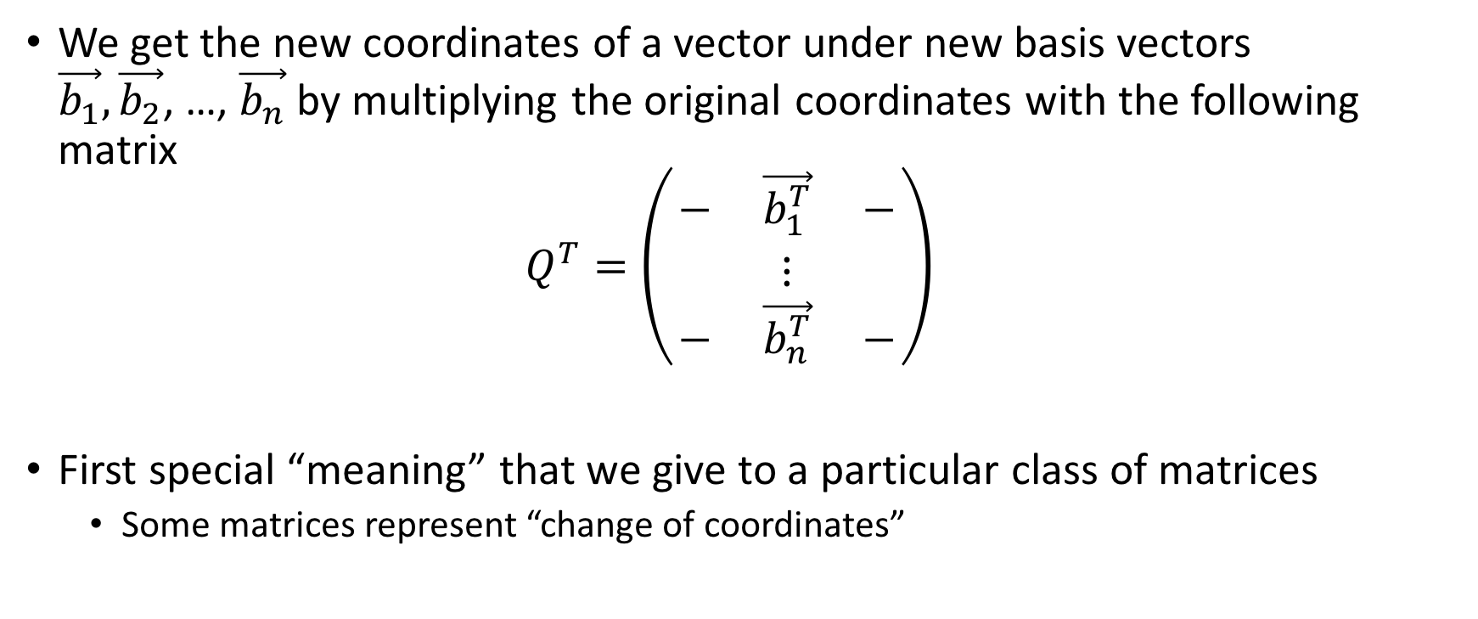
Matrix for Change of Coordinates
We get the new coordinates of a vector under new basis vectors $\vec{b_{1}},\vec{b_{2}}$, …, $\vec{b_{n}}$by multiplying the original coordinates with the following matrix
$Q^{T}=\left(\begin{matrix}− & \vec{b_{1}^{T}} & − \\ & ⋮ & \\ − & \vec{b_{n}^{T}} & −\end{matrix}\right)$
First special “meaning” that we give to a particular class of matrices
  Some matrices represent “change of coordinates”

Slide 17
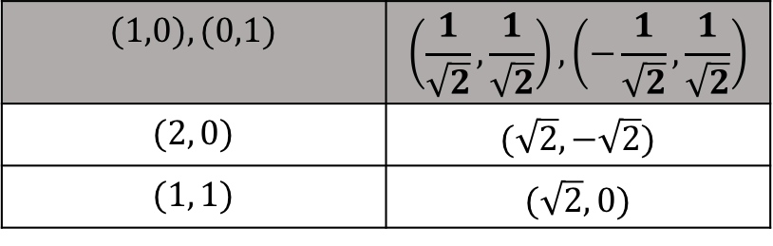
Matrix for Change of Coordinates: Example
$\left(\begin{matrix}\frac{1}{\sqrt{2}} & \frac{1}{\sqrt{2}} \\ −\frac{1}{\sqrt{2}} & \frac{1}{\sqrt{2}}\end{matrix}\right)\left(\begin{matrix}2 & 1 \\ 0 & 1\end{matrix}\right)=\left(\begin{matrix}\sqrt{2} & \sqrt{2} \\ −\sqrt{2} & 0\end{matrix}\right)$
$$(1,0), (0,1)$$ | $$\left(\frac{1}{\sqrt{2}},\frac{1}{\sqrt{2}}\right), \left(−\frac{1}{\sqrt{2}},\frac{1}{\sqrt{2}}\right)$$
$$(2, 0)$$ | $$(\sqrt{2}, −\sqrt{2})$$
$$(1, 1)$$ | $$(\sqrt{2}, 0)$$

Slide 18
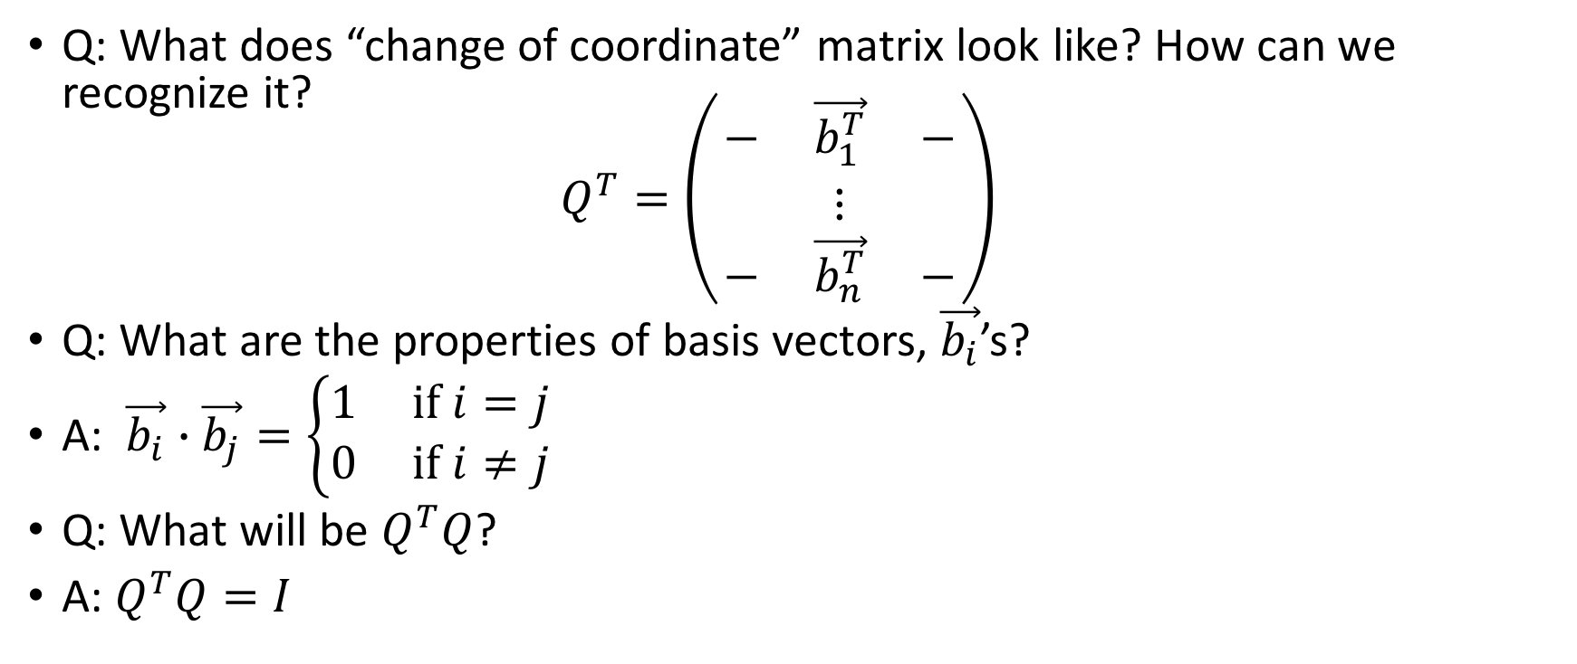
Matrix: Change of Coordinates
Q: What does “change of coordinate” matrix look like? How can we recognize it?
$Q^{T}=\left(\begin{matrix}− & \vec{b_{1}^{T}} & − \\ & ⋮ & \\ − & \vec{b_{n}^{T}} & −\end{matrix}\right)$
Q: What are the properties of basis vectors, $\vec{b_{i}}$’s?
A: $\vec{b_{i}}∙\vec{b_{j}}=\left\{\begin{matrix}1 if i=j \\ 0 if i≠j\end{matrix}\right.$
Q: What will be $Q^{T}Q$?
A: $Q^{T}Q=I$

Slide 19
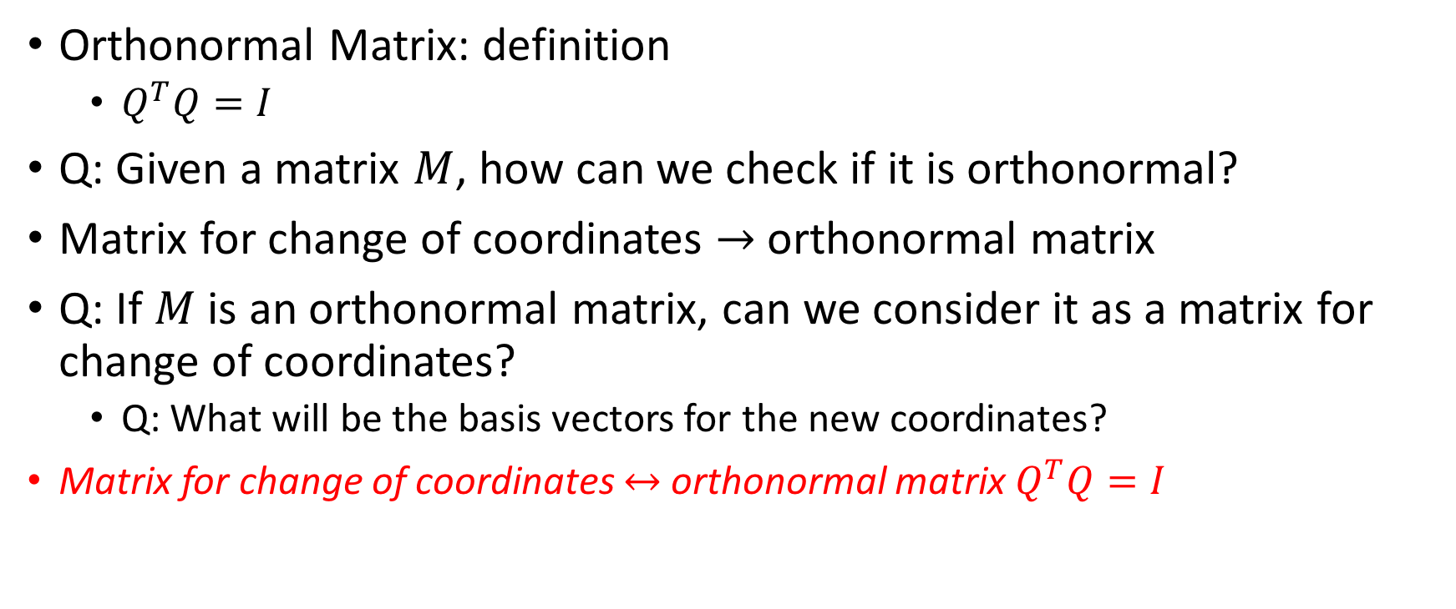
Change of Coordinates: Orthonormal Matrix
Orthonormal Matrix: definition
  $Q^{T}Q=I$
Q: Given a matrix $M$, how can we check if it is orthonormal?
Matrix for change of coordinates $→$ orthonormal matrix
Q: If $M$ is an orthonormal matrix, can we consider it as a matrix for change of coordinates?
  Q: What will be the basis vectors for the new coordinates?
  Matrix for change of coordinates $↔$ orthonormal matrix $Q^{T}Q=I$

